Slide 1
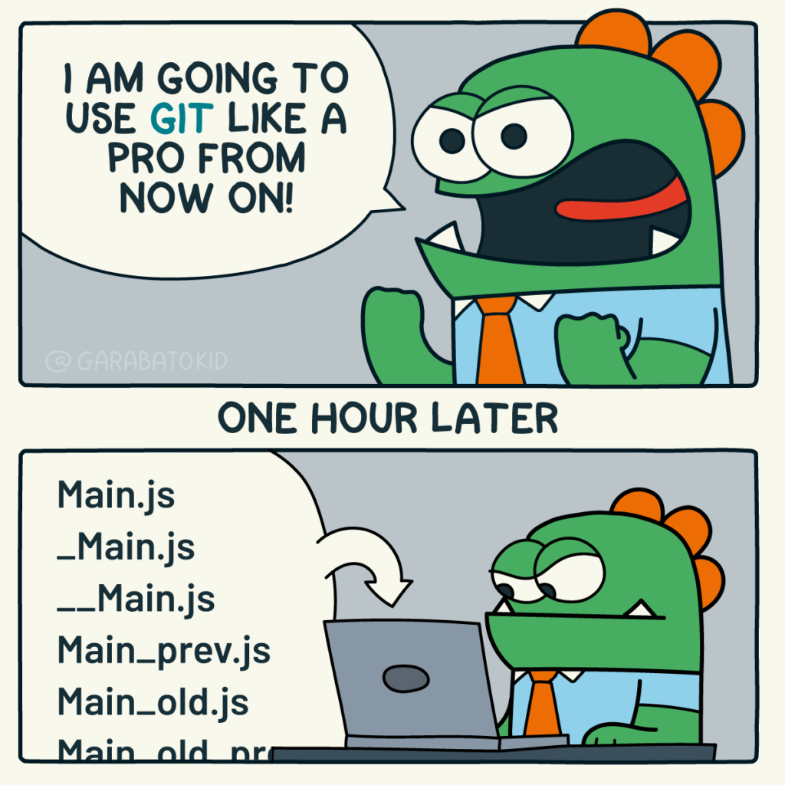
Version control with Git

Slide 2
Why Git
What is Git
How to use Git

Slide 3
Why Git?
(or any other version control software)

Slide 4
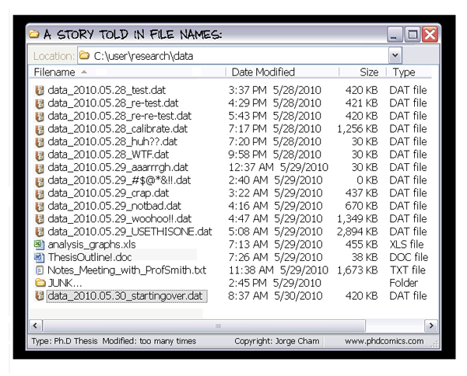
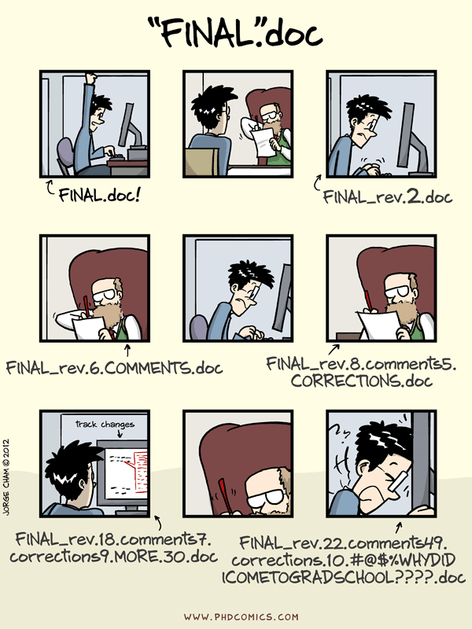
Situation # 1: Review of a draft document (offline mode)
Difficult to know which copy of the document contain which change.
Duplication of the same information many times, occupying space of your hard drive.

Slide 5



Situation # 2 : A group coding project
Project copy # 1
Project copy # 2
Project copy # 3
Alice merges her changes , reviews and maintains the final copy
Laura merges her changes and sends it to Alice
John makes his changes and send his project to Laura
Alice
Laura
John
Challenge: How to merge all these different copies together and maintain a final copy of the project?
Notes:
Here talk about the challenges when working a group project of code for example without using version control

Slide 6
Situation # 2 : A group coding project
Consequences of the presented solution to integrate all changes from team members to the project:
Manual approach
Time consuming
Error prone
Not scalable
Inefficient
Thus , we need an efficient system that track different versions of a project and allows the team to know who has made changes to the project, when and why !
Challenge: How to merge all these different copies together and maintain a final copy of the project?

Slide 7
What is Git?

Slide 8

Git is the most used version control system. More than 90% of software projects around the world use Git.
It was created in 2005 by Linux Torvalds , the same creator of Linux OS.
It is free, open source, fast and scalable.
It is a version control software meant to keep track of the entire history of a project and allows collaboration of any size.
Git + Github(Gitlab) allows the distributed/ de-centralized collaboration within the team of collaborators.

Slide 9
How to use Git?
The workshop of today!

Slide 10
Tools
Unix terminal (Git Bash for Windows or WSL)
Git
Browser
GitHub account

Slide 11
Schedule
13:30 – 13:45 Git Intro
13:45- 14:30 Setting up a local Git :
Configuration and Initialization of a Git project
14:30- 14:45 Break
14:45- 15:45 Git cycle and Ignoring things
15:30-15:45 Exercise in breakout rooms
15:45-16:00 Break
16:00-17:00 Exploring the history. Concluding remarks

Slide 12


Slide 13
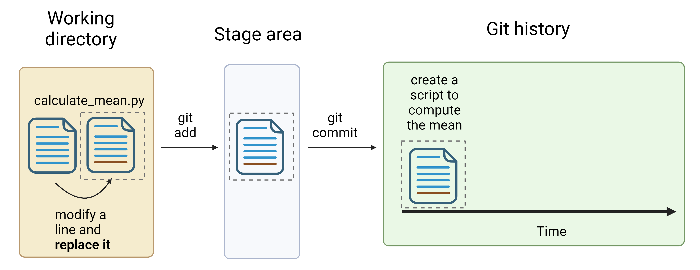
The working directory- stage area and git history relationship

Slide 14
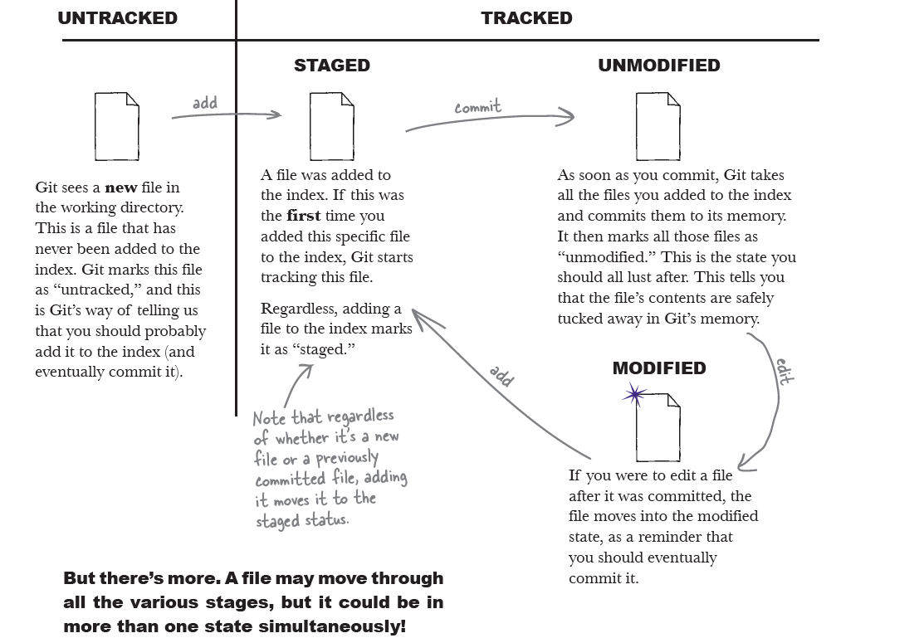
Gandhi, R. (2022). Head First Git. " O'Reilly Media, Inc.".

Slide 15
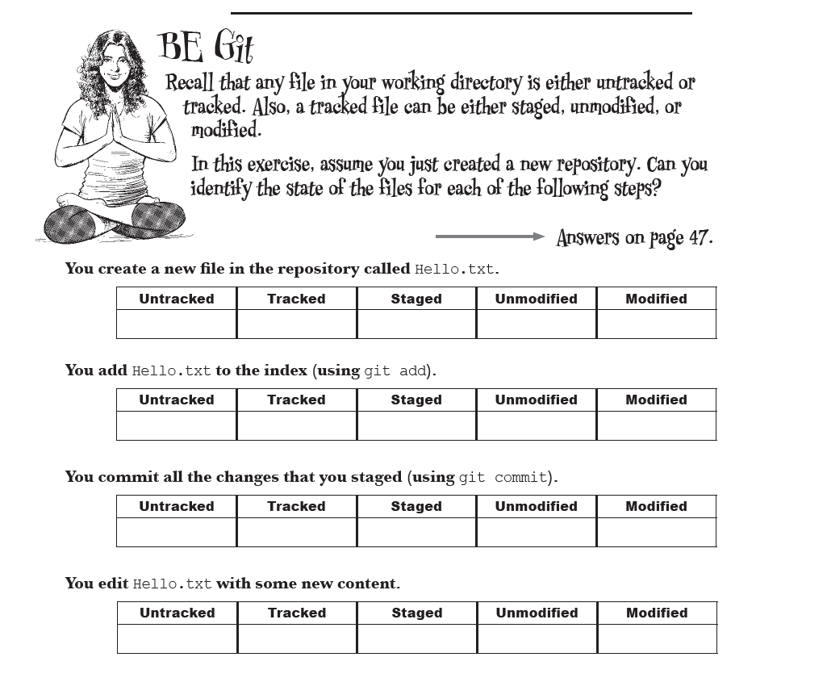
Gandhi, R. (2022). Head First Git. " O'Reilly Media, Inc.".

Slide 16
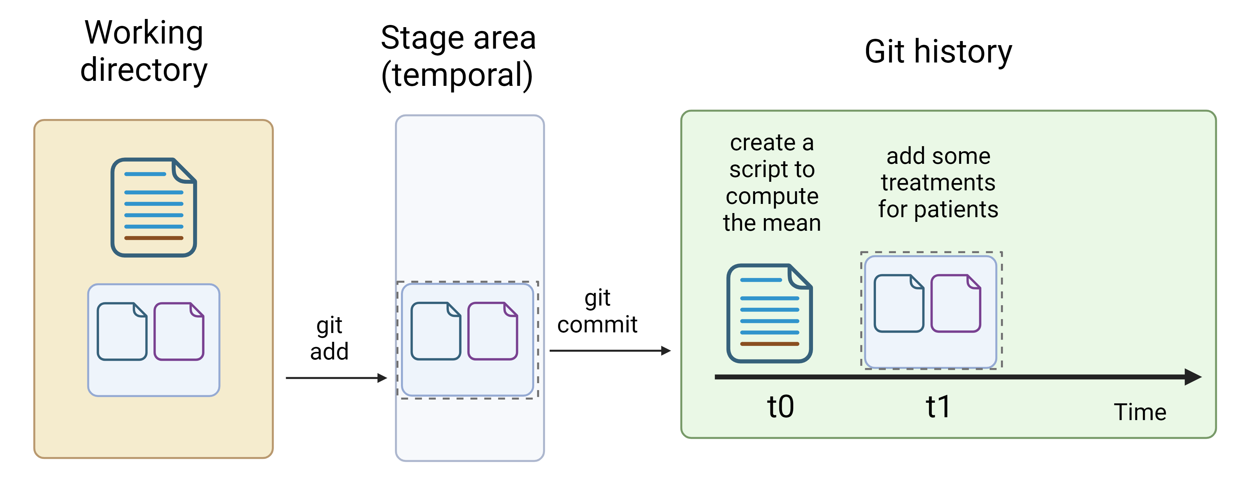
The working directory- stage area status

Slide 17
